Slide 1
FACADE PATTERN
A patterns-box talk
by
Claudia Montalvo
“The face of the building”
Notes:
Hi guys, thank you all for attending. This presentation is to talk about facade design pattern as part of patterns-box talk.

Slide 2
About me
Hi, This is Claudia, Senior Developer at Belatrix. Currently working at Delta Team on Enterprise APIs.

Slide 3
01
02
03
04
05
What is a pattern?
Goal
Architecture
Real world case
Problems it solves

Slide 4
06
07
08
09
10
When to use it?
Effects
Common mistakes
Demo
Summary

Slide 5

What is a Pattern?
General repeatable solution to a commonly occurring problem in software design.

Slide 6

Goal
Simplify how to consume a complex existing system.

Slide 7

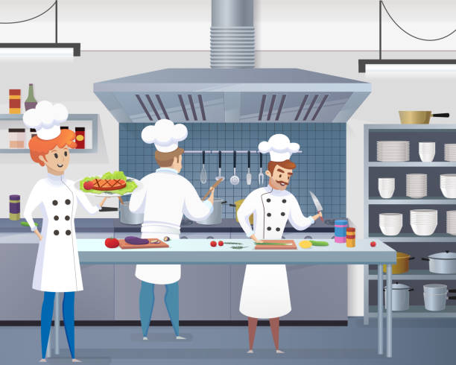
Architecture
Clients
Kitchen

Slide 8

Architecture
Other Subsystem
Waiter
Order Facade
Kitchen
Other Subsystem
Other Subsystem
Customers

Slide 9







Real world case
Clients
Subsystems
Facade

Slide 10

Problems it solves
Reduces the learning curve of the subsystem.
Makes a subsystem easier to use by wrapping it.
Decouple subsystems from its clients
Limit/restrict features and flexibility that users may need.

Slide 11

When to use it
Need to expose a complex system in a simplified way to consume and use
A system is too complex and difficult to understand
Wrap a poorly designed API in a better designed one

Slide 12
When to use it
Expose a set of complex interactions with a single interface
Integrate your app with sophisticated libraries with tons of functionality
When you are planning to change the subsystem in the future

Slide 13

Effects
Existing subsystem is simplified
Create new/ Update Facade to expose more functionality
Full capability of subsystems will not be available from Facade

Slide 14

Common Mistakes
Creating unnecessary facades.
Forcing client classes to interact with subsystem through the facade.
Create facade layer for simple calls.
Creating facade layer in advance.

Slide 15
Common Mistakes
Reference for facade in subsystems.
Adapter and Facade are both wrappers but they are differents.
A facade can become a god object coupled to all classes of an app.

Slide 16

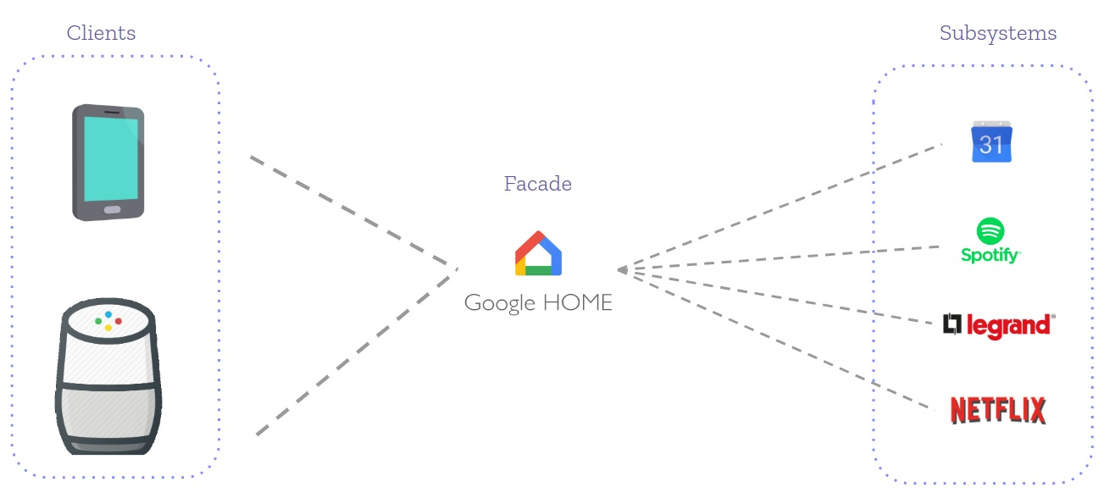
Live code

Slide 17
Summary
Facade provides a single interface
Developers comfort is a main purpose of facade
Simplicity is the aim of facade
Facade promotes subsystem independence and portability
Subsystem may be dependent with another one.

Slide 18



